Slide 1
Monasca Monitoring for Kubernetes:
Delivered on OpenStack

Slide 2


Christoph Held (Kubernetes)
christoph.held@est.fujitsu.com
@christoph on slack
Witek Bedyk (Monasca)
witold.bedyk@est.fujitsu.com
witek in #openstack-monasca

Slide 3

What is Monasca?

Slide 4
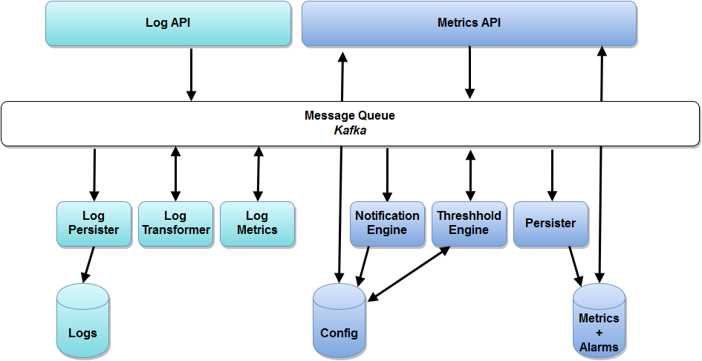
Architecture of Monasca
Notes:
Monitoring and Logging APIs
Highly performant, scalable and fault-tolerant
Built on
Apache Kafka
Apache Storm
InfluxDB/Cassandra
ELK stack
Metrics storage, retrieval, thresholding and notifications

Slide 5

What is Kubernetes?
Notes:
A quick recap on Kubernetes
Kubernetes is a exciting technology. It is designed for managing containerized applications in a clustered environment. It abstracts the complexity of scheduling containers to nodes and routing traffic between containers even in case of node failures or horizontal scalings
Perfect tool for developing a micro service application in a DevOps team.
Kubernetes is very lightweight, so bare metal installations scale from a single Raspberry Pi to a 1000 node datacenter. Kubernetes can also be installed on VMs such as OpenStack. Me and my team we make sure integration with OpenStack is smooth.

Slide 6
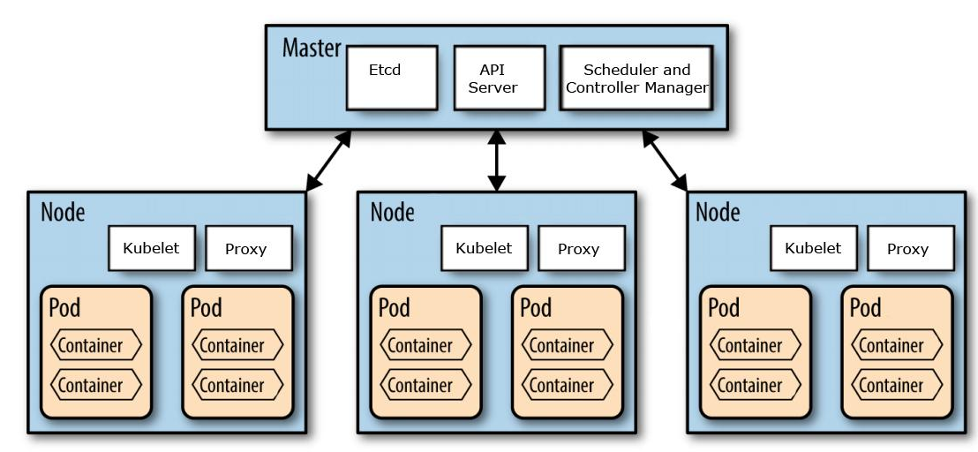
Architecture of Kubernetes
Notes:
Kubernetes consists of on or up to three masters and many nodes.
Master contains a couple of control components
Etcd -the database
API server
Controller manager
Every node contains a kubelet. Kubelet is an agent that receives commands from master. A proxy is used to route the traffic between pods.
Finally, we have pods that contain the actual containerized applications. Pod is smallest scheduling unit. With pods one can make sure that containers will be co-located.

Slide 7

Monitoring Situation
Notes:
In our scenario we assume that
OpenStack is your platform of choice
Monasca is available as a service offering from your OpenStack provider.
Kubernetes is deployed on top
What you achieve with is basically similar to the cloud monitoring integration of GKE. GKE is the container offering from Google

Slide 8
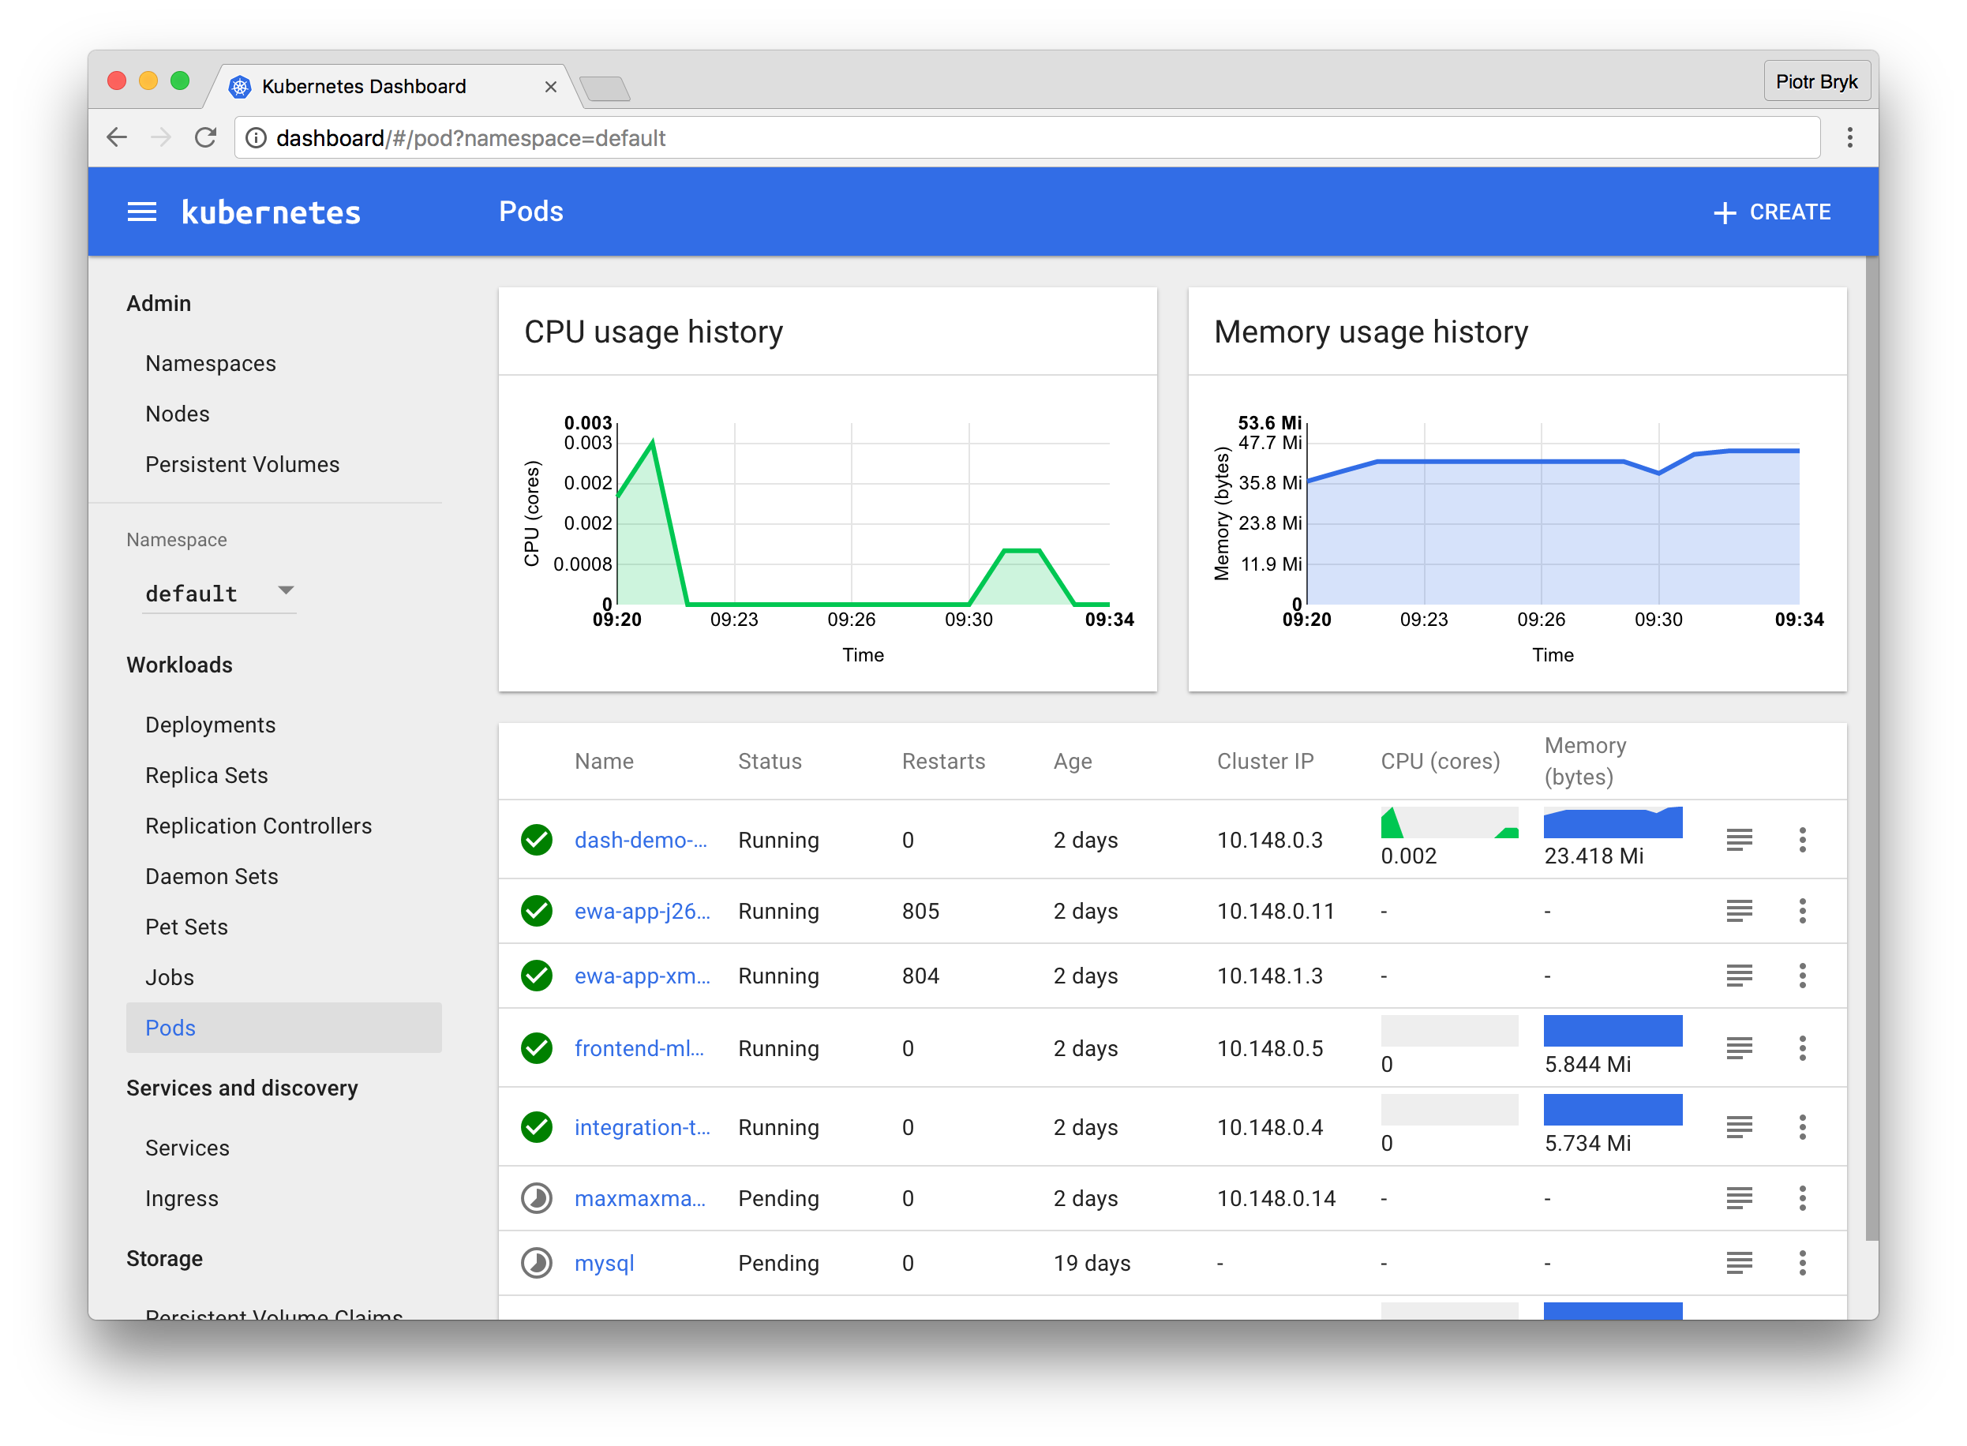
Kubernetes Dashboard
Notes:
Before we continue I want to elaborate on monitoring in Kubernetes
This is the Kubernetes Dashboard project. It is the management and troubleshooting UI of Kubernetes.
Kubernetes Dashboard is also developed in large parts by my team.
Dashboard is not a usual monitoring systems. We focus on user problems. We collect information from different sources, aggregate and link everything together along their use cases. Super easy to use, but not possible to change or customize.
Now, lets look at the architecture

Slide 9
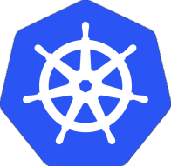

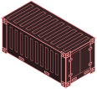
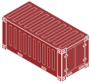
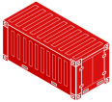
Metrics
Kubernetes Cluster
Dashboard
Node 1
C1
C2
C3
Containerized
Workload
Collect
metrics
Container Runtime
cAdvisor
Heapster
kubelet
Notes:
This diagram shows how metrics are processed in Kubernetes: On the left hand side you can see a couple of Kubernetes nodes that run
some containerized workloads
Containers are processes that can be monitored. Cadvisor is a metrics agent from Kubernetes and exposes metrics via REST interface. It is part of kubelet and installed by default. cAdvisor is completely stateless.
The next component is Heapster. It is a singelton in the cluster. It queries the API server to get the list of all nodes and then iterates over the node list and collects the metrics from cadvisor. Heapster scrapes every 60 seconds and keeps 15 min of data in memory. No persistence.
Dashboard accesses Heapster - therefore no historic data and no custom data (e.g. active user sessions)

Slide 10
Logs
Kubernetes Cluster
Dashboard
Node 1
C1
C2
C3
API Server
Containerized
Workload
Container Runtime
kubelet
Log files
Notes:
Now, let's look at the logs.
The applications write their logs to standard out. The container runtime stores the logs into files on disk.
Kubelet fetches the log files and returns the content to Dashboard. There is no special processing like indexing. Therefore Dashboard does not provide search

Slide 11
Kubernetes Dashboard
The Good
Works out of the box
Easy to use
The Bad
No historic data
No search
No customizable UI
No alerts & triggers

Slide 12
Why Integrate with Monasca?
Strengths of Monasca:
Historic data ✔
Search ✔
Customizable UI ✔
Alerts & triggers ✔
Additional benefits of using an OpenStack service:
No operational costs ✔
Infrastructure metrics in mixed environments ✔
Notes:
So, what is the benefit of integrating Kubernetes with Monasca?
All the limitations we have identified are actually the strengths of Monasca
The best benefits:
if your cloud provider operates Monasca then you don't have to worry yourself.
Mixed setups (DB on VMs)

Slide 13

Integration Points
Notes:
Connecting Kubernetes with Monasca is realized by forwarding
1.metrics and
2. logs
It is important to understand that we only change the Kubernetes configuration, but not modify the applications running inside Kubernetes. So you can deploy any application to kubernetes and metrics and logs automatically appear at Monasca
Now, let's move forward to the actual implementation for metrics

Slide 14


Integration: Metrics
Kubernetes Cluster
Monasca
Dashboard
Node 1
C1
C2
C3
Containerized
Workload
Collect
metrics
Forward metrics
Container Runtime
cAdvisor
Heapster
kubelet
Monasca
sink
Notes:
Let's look at the metrics first
Again metrics are collected by cAdvisor and Heapster as before. But now we have integration with Monasca
Heapster has an extension point mechanism called sink. Custom sinks allow to forward metrics to other systems. We have implemented the ‘monasca-sink’ and it is part of the Kubernetes distribution.
So you just have to enable it to forward metrics to Monasca API server.
In the latest version of monasca, the metrics agent can collect container metrics. Another Option. But not tried yet

Slide 15

Integration: Logs
Kubernetes Cluster
Monasca
Dashboard
Node 1
C1
C2
C3
Containerized
Workload
API Server
Container Runtime
kubelet
Forward logs
Monasca
log agent
Log files
K8S daemon set
Notes:
Now, let's look at the logs.
Again, everything is the same as before. The containers log to standard out and the container runtime stores the logs into files on disk.
To integrate with Monasca, you can do so by deploying the Monasca log agent as Kubernetes daemon set. A daemon set is ideal for this task as Kubernetes will deploy one pod instance on each node. This works even when you scale up and scale down the number of cluster nodes. Always you have one Monasca log agent on every node.

Slide 16

Mapping Data to Monasca
Setup
Notes:
Metric
service = Kubernetes
component = <pod-name>
hostname = <hostname>
container_name = <container_name>
Logs
type = kubernetes.containers
hostname = <hostname>
podname = <pod-name>
container = <container-name>

Slide 17
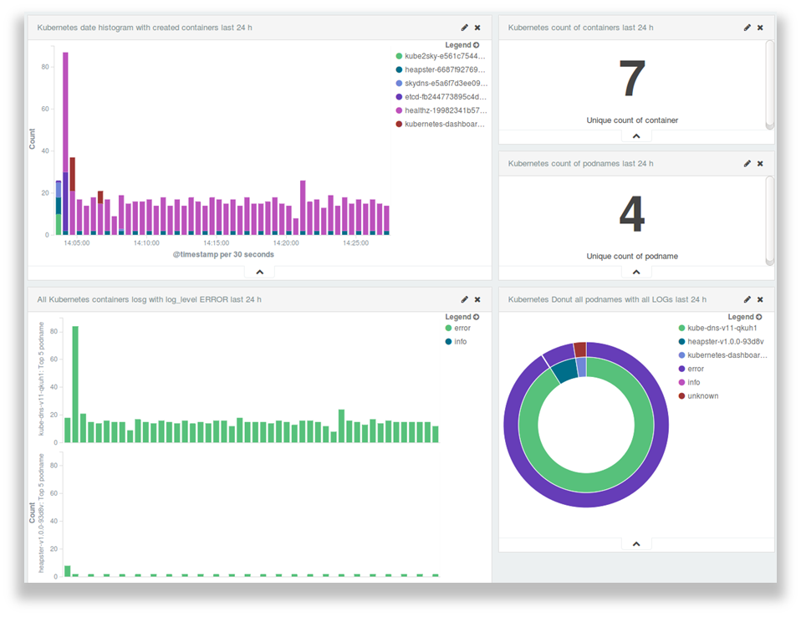
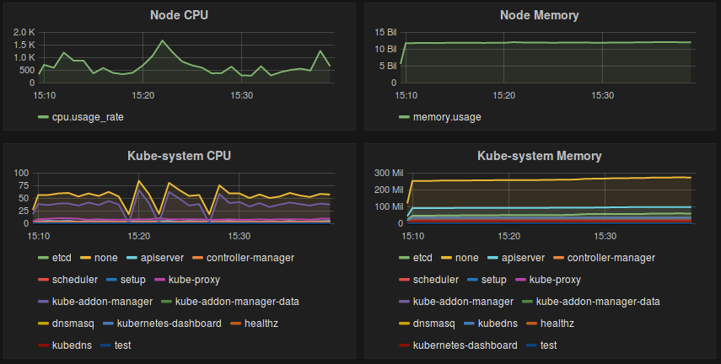
Custom Visualizations
Metrics
Logs

Slide 18
Alerting Based on Metrics and Logs
Examples:
404 page not found
count(log.error {service=kubernetes, container_name=wordpress, code=404}, deterministic) > 10
No purchase in web-shop since 10 minutes
count(log.event {service=kubernetes, container_name=webshop, type=purchase}, deterministic, 600) = 0
CPU usage high and log errors
avg(cpu.utilization_perc) > 90 times 3 AND max(log.error, deterministic) > 0

Slide 19

Live Demo....
Notes:
I am running a one node Kubernetes cluster on this notebook. Currently, it’s empty.
Let's deploy the guestbook sample application. As you notice, it just works. Just remember how complicated it was to work with virtual machines:
you have to log in to each machine
install library software on every machine.
install the software
configure all the config files
people come up with chef, and all this things that never really worked
also monitoring - no configuration - no agent installed
That’s why Kubernetes is so awsome - things just work as they should
Scale up
Drill down from various view points.
Resource Aggregate for the wl.
Limitations
-I cannot select a time range - no historic data
-I cannot add my own graphs - no customizable ui
-I have to page through logs for each container - no search
-and i cannot set alerts

Slide 20

What is coming next?
Notes:
So far we have not talked about cluster auto-scaling.

